Slide 1
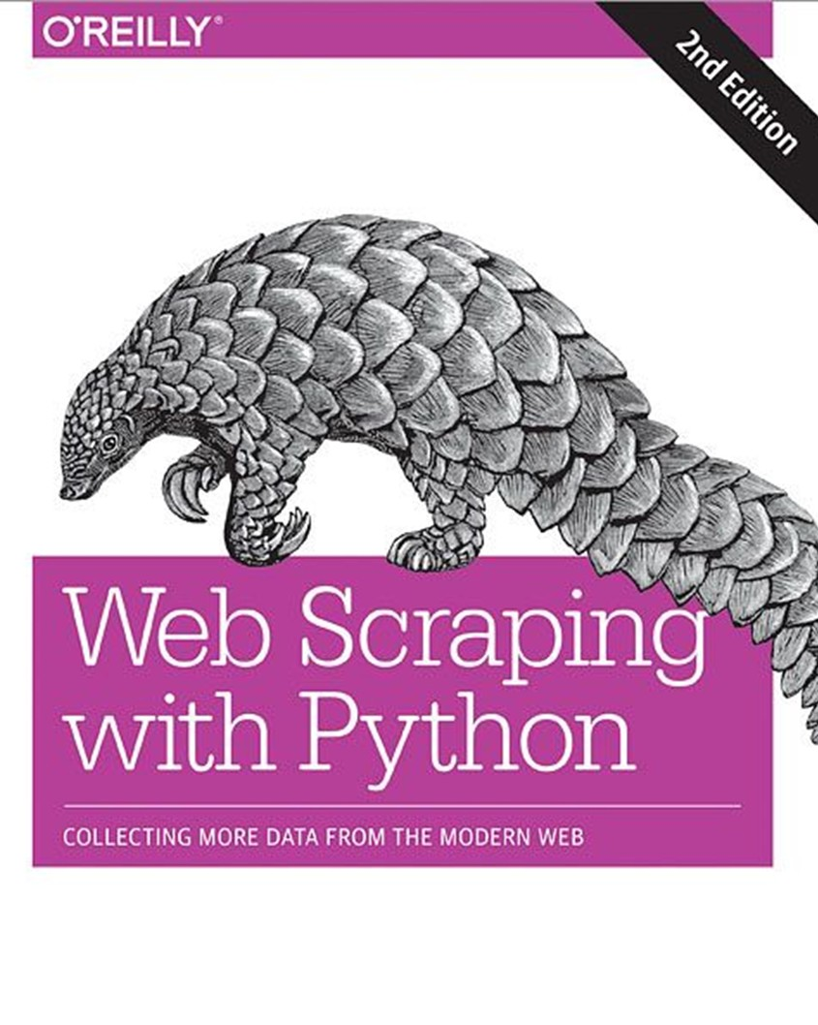
WEB SCRAPING WITH PYTHON:
COLLECTING MORE DATA FROM THE
By Olha Kravets
MODERN WEB

Slide 2

About the Author
Ryan Mitchell
Ryan Mitchell is a senior software engineer at HedgeServ in Boston, where she develops APIs and data analytics tools for hedge fund managers

Slide 3
About Web Scraping With Python
«The tools and examples included in the book allowed me to easily automate several repetitive tasks, freeing that time to solve more interesting problems. It is a results-oriented, quick read that is well rooted in real-world problems and solutions."
-Eric VanWyk Electrical Computer Engineer, Olin College of Engineering

Slide 4
Table of Contents
Your First Web Scraper
Advanced HTML Parsing
Writing Web Crawlers
Web Crawling Models
(Part 1)
Scrapy
Storing Data and click on 'Record yourself'.

Slide 5
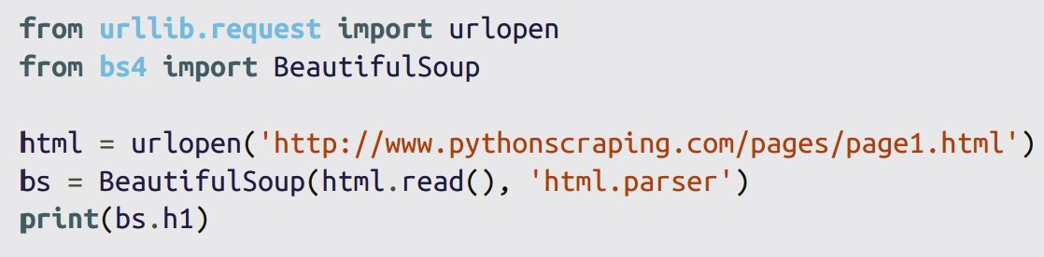
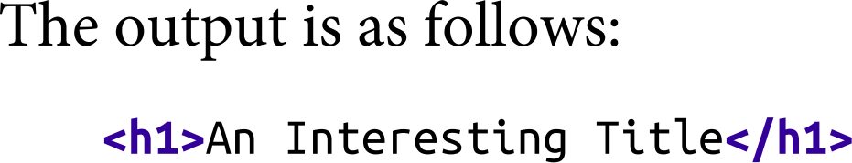
Chapter 1. Your First Web Scraper
Connecting
An Introduction to BeautifulSoup
Installing BeautifulSoup Running BeautifulSoup
Connecting Reliably and Handling Exceptions

Slide 6
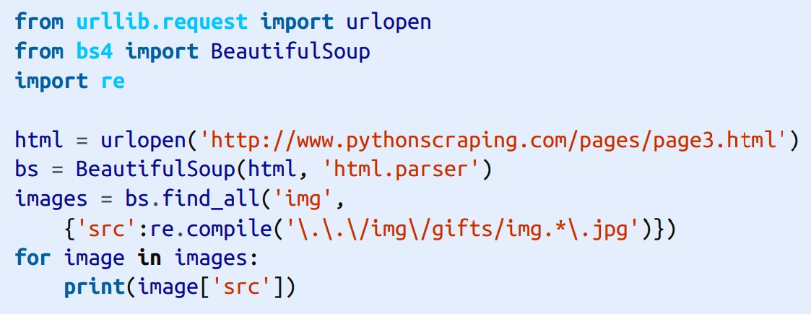
You Don’t Always Need a Hammer
Chapter 2. Advanced HTML Parsing
Another Serving of BeautifulSoup
find() and find_all() with BeautifulSoup Other BeautifulSoup Objects Navigating Trees
Regular Expressions
Regular Expressions and BeautifulSoup
Accessing Attributes
Lambda Expressions

Slide 7
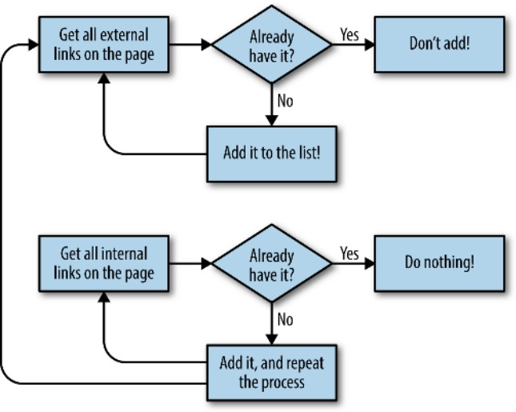
Chapter 3. Writing Web Crawlers
Traversing a Single Domain
Crawling an Entire Site
Collecting Data Across an Entire Site
Crawling Across the Internet
Flow diagram for the website crawler that collects all external links

Slide 8
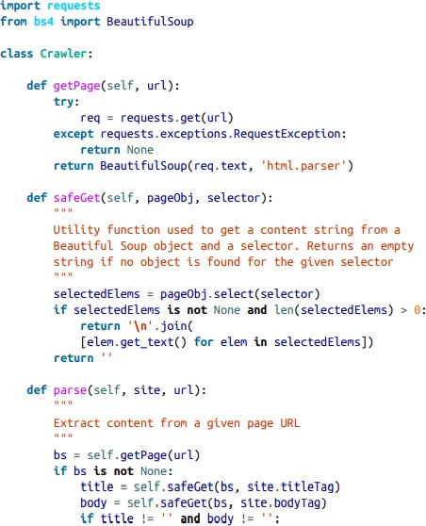
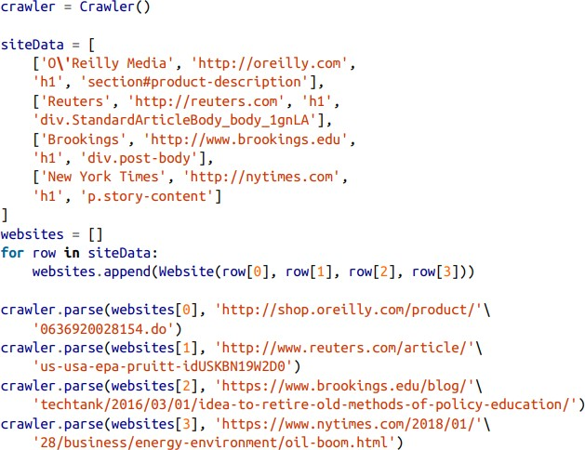
Chapter 4. Web Crawling Models
Planning and Dealning Objects
Dealing with Different Website Layouts
Structuring Crawlers
Crawling Sites Through Search Crawling Sites Through Links Crawling Multiple Page Types
Thinking About Web Crawler Models

Slide 9
Thank you for
listening!

